Slide 1
Class Management System
Name Roll no Seat no
Heni Patel 3115 0430
Pritesh Makwana 3074 0860
Priyal Maheshwari 3138 1088
CU Shah Institute of Computer Applications

Slide 2
Introduction
The Project is titled ‘Class Management System’.
Our Project aims to serve as a platform which makes it easier for the admin to manage student and teacher data
Also the app can help students and teachers to share data more effectively as all data is stored together.

Slide 3
Project Profile
Name | Class Management System
Objective | Create a mobile application to read and submit assignments, pay salary and fees, manage student and teacher data & upload Notice and Timetable.
Platform | Android Studio (Dolphin)

Slide 4


Tools and Technologies
Android Studio (Dolphin) provides a unified environment where you can build apps for Android devices. Structured code modules allow you to divide your project into units of functionality that you can independently build, test, and debug.
Java is a programming language and a platform. Java is a high level, robust, object-oriented and secure programming language.
Front End
Backend
Firebase is a set of backend cloud computing services and application development platforms provided by Google. It hosts databases, services, authentication, and integration for a variety of applications, including Android, iOS, JavaScript, Node.js, Java, Unity, PHP, and C++

Slide 5
Application Screenshots

Slide 6
01
Admin App
Admin has the sole access to all data

Slide 7
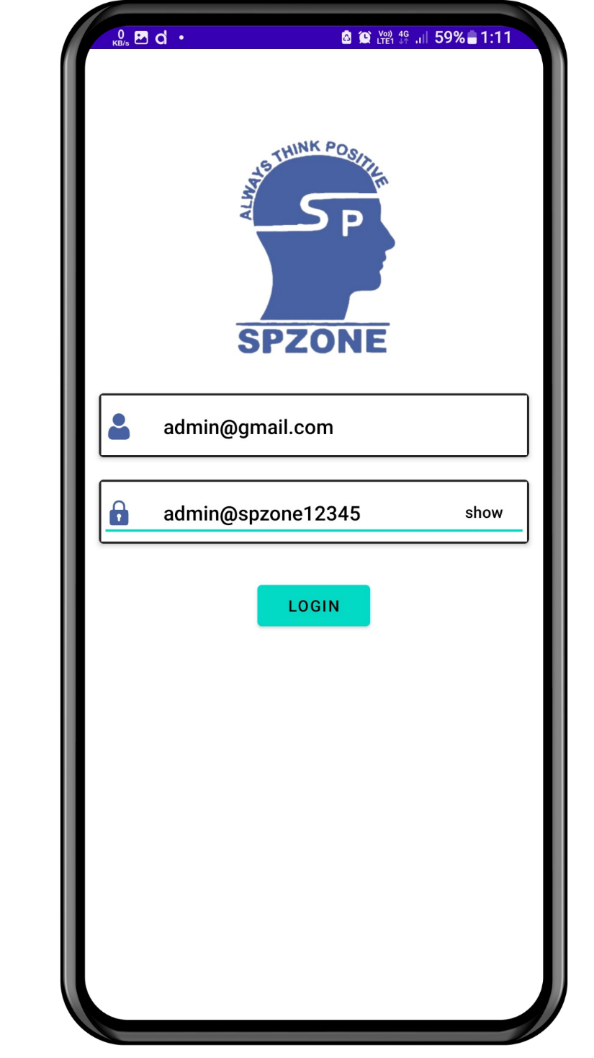
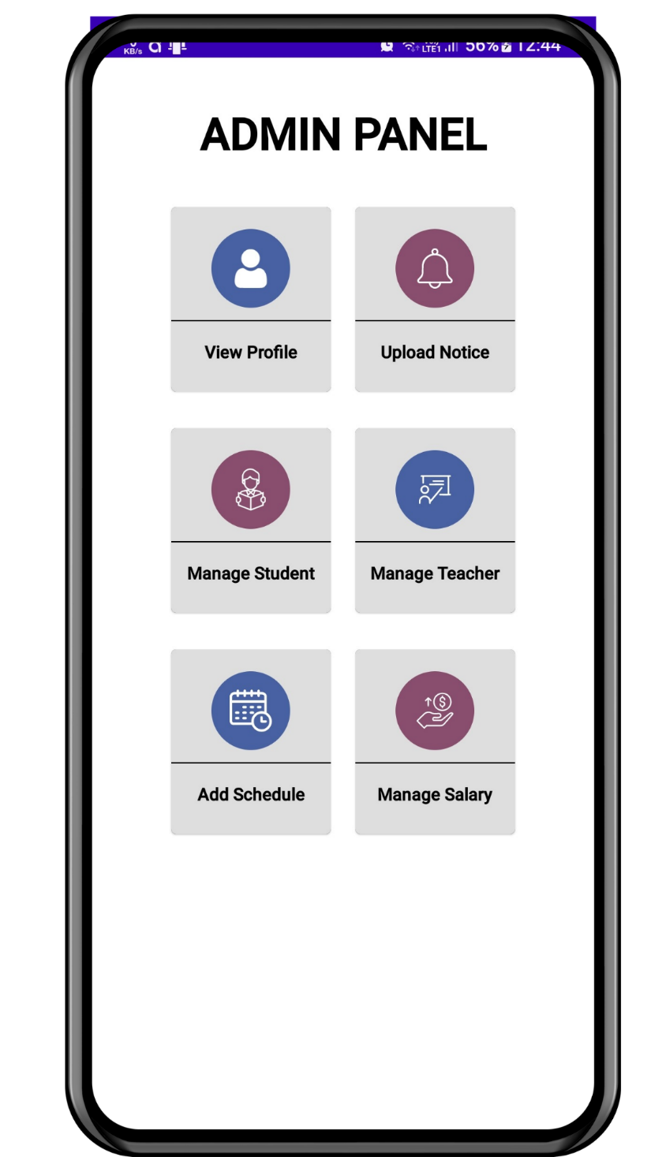
Admin Login and dashboard

Slide 8
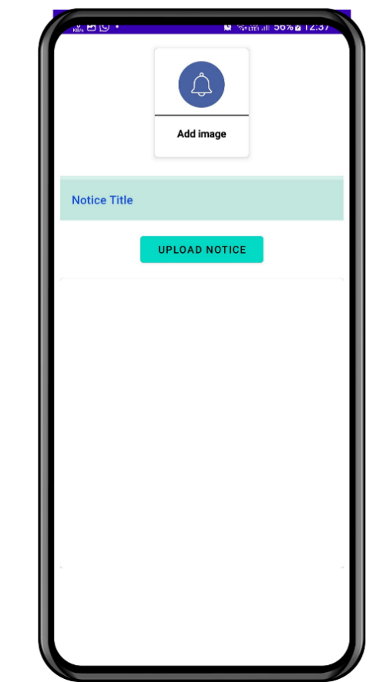
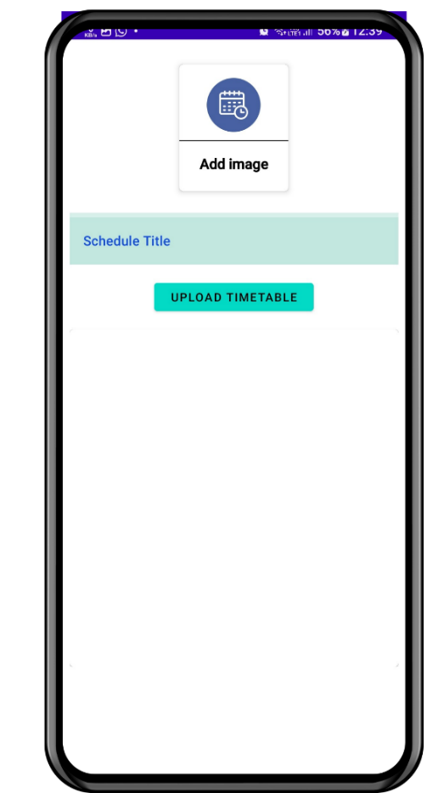
Add Notice , schedule

Slide 9
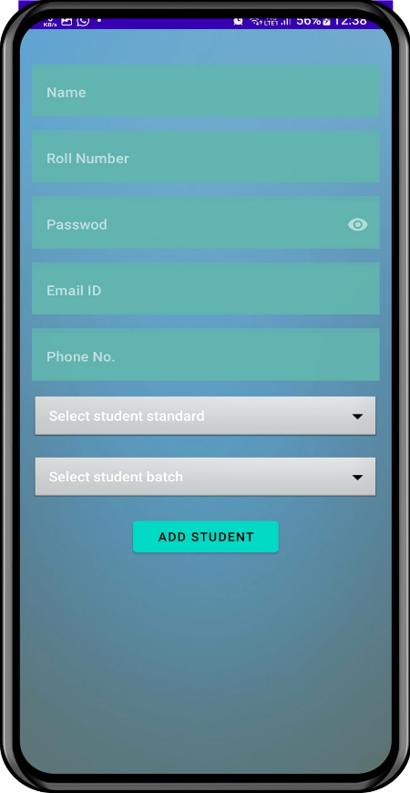
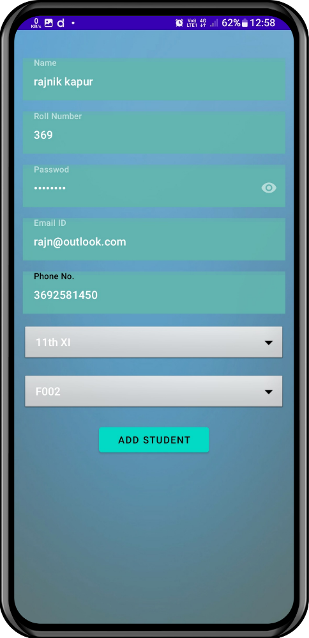
Add Student

Slide 10
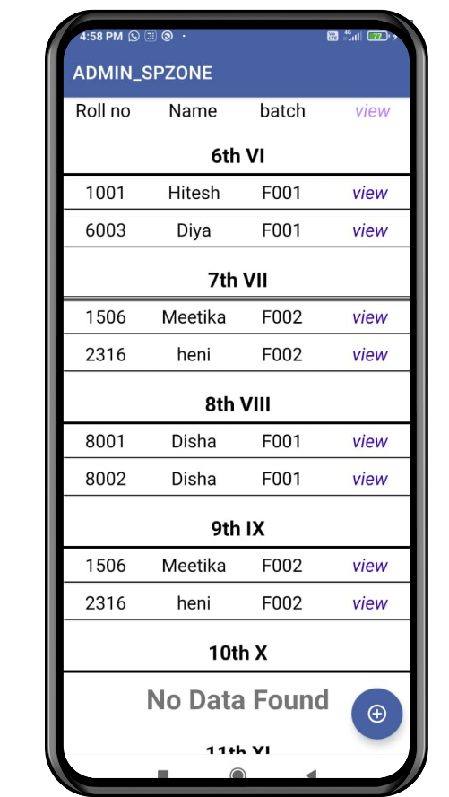
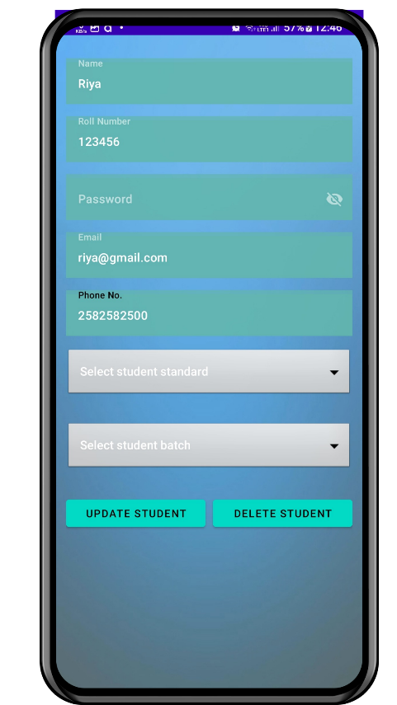
View, update Student

Slide 11
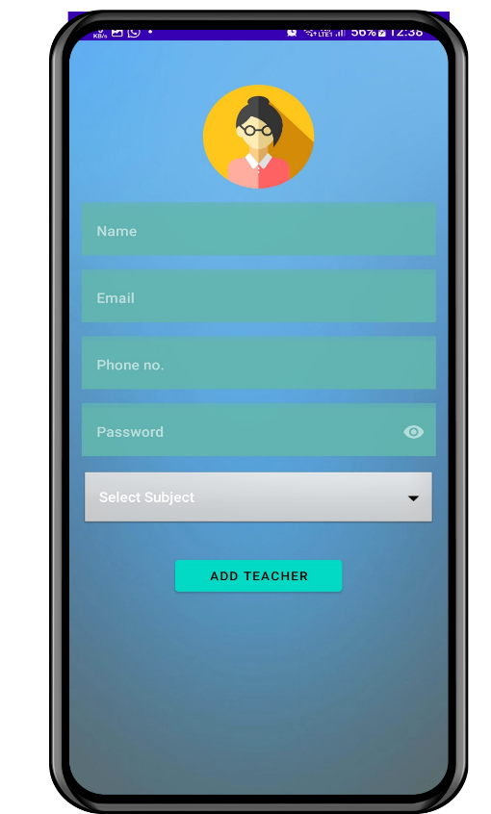
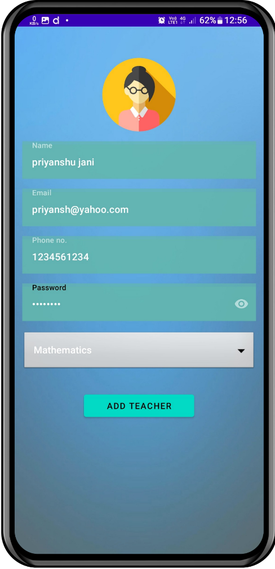
Add Teacher

Slide 12
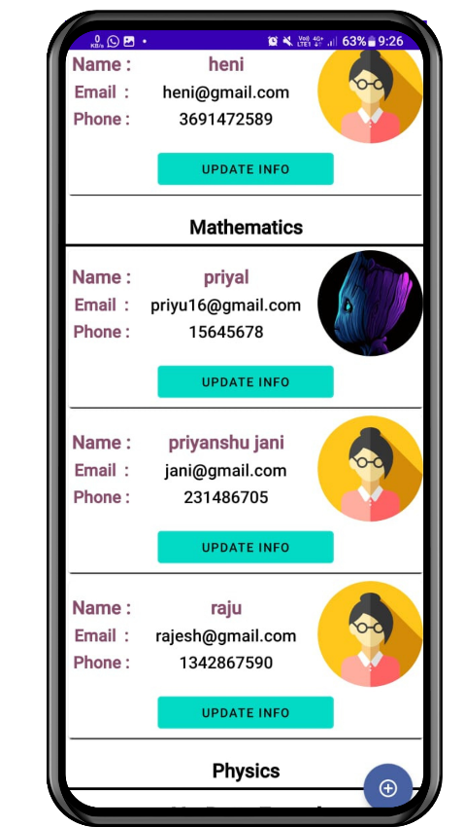
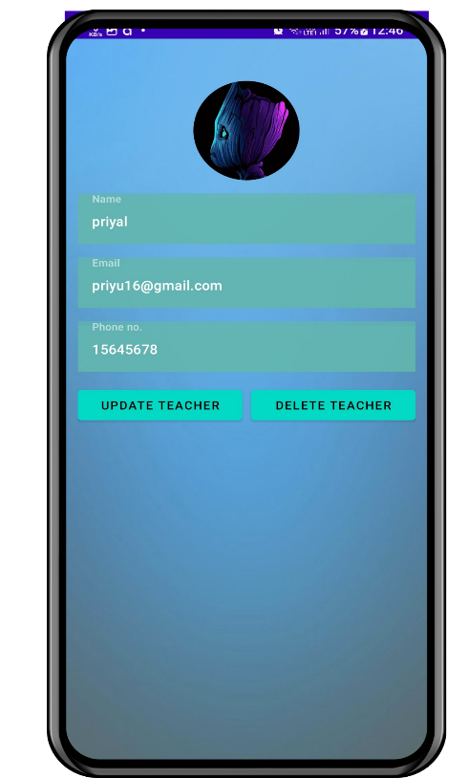
View, update Teacher

Slide 13
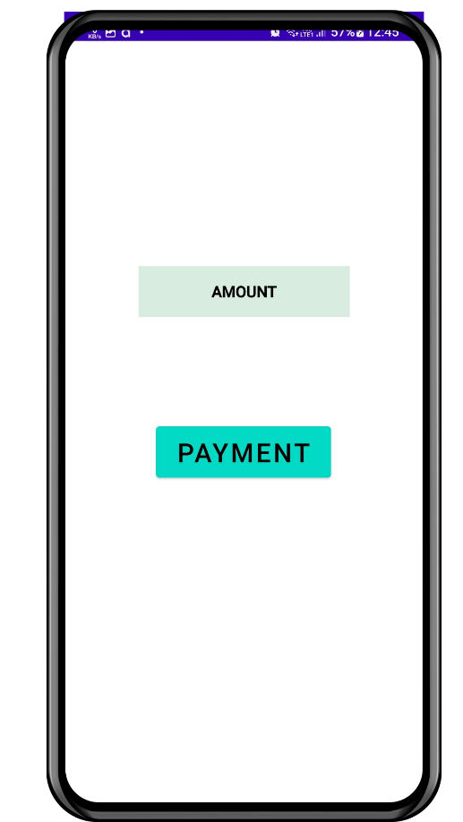
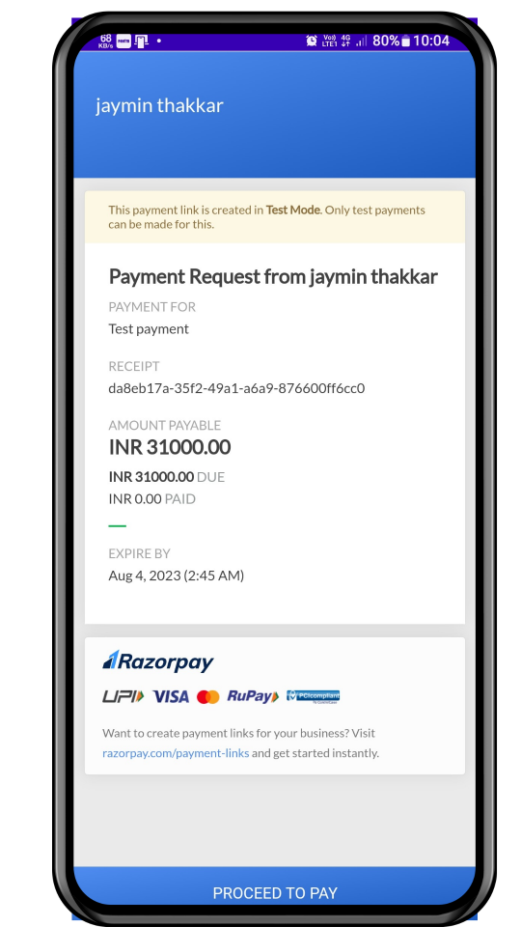
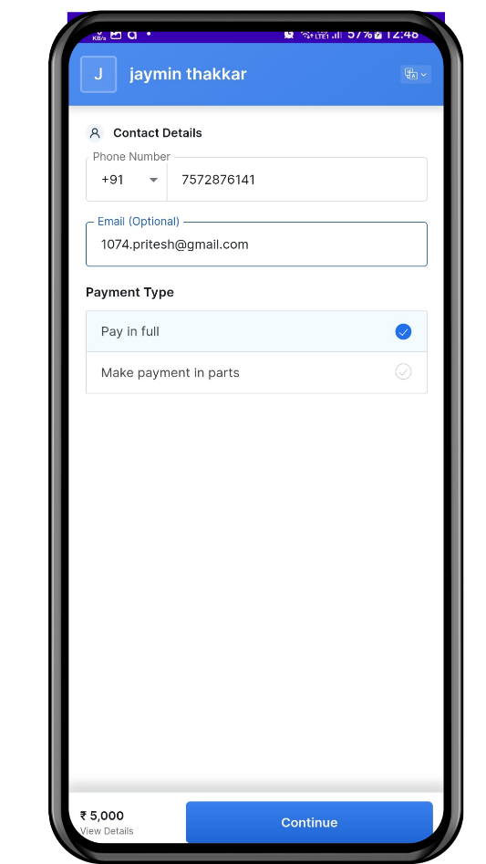
Pay Salary -01

Slide 14
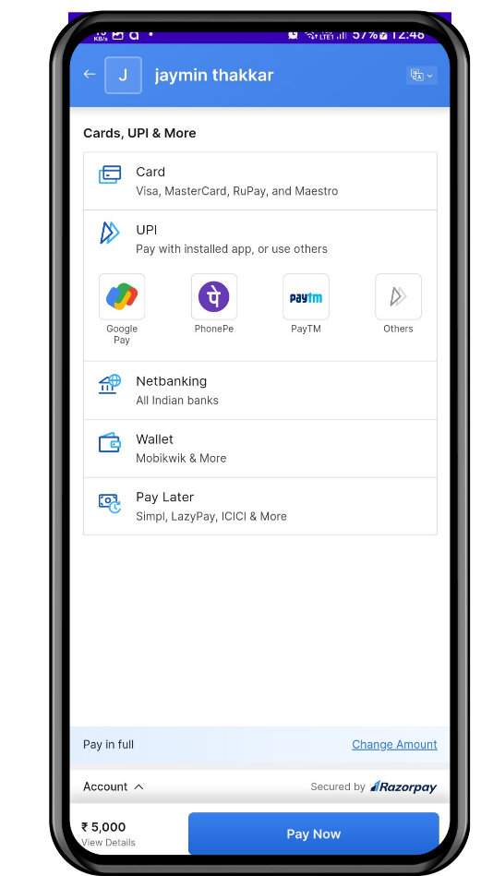
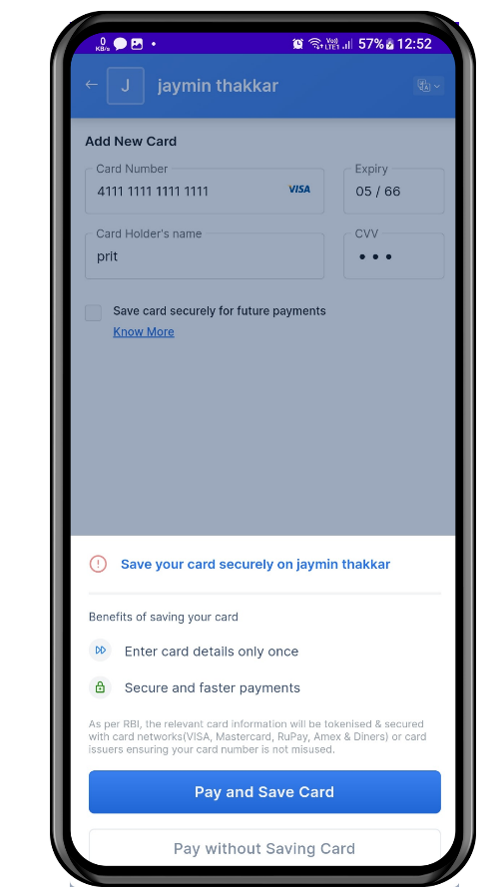
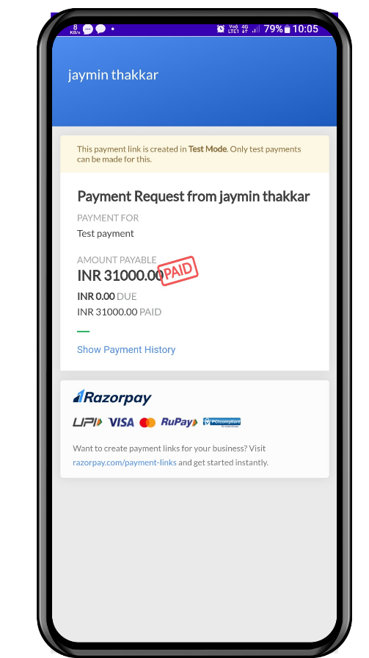
Pay Salary -02

Slide 15
02
Student App
User panel consists of teachers and students

Slide 16

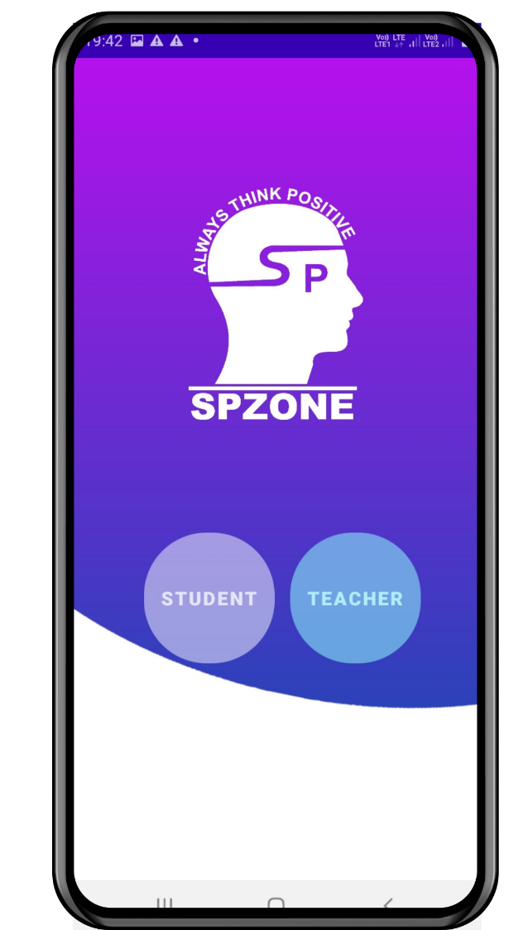
Splash and Home Page

Slide 17
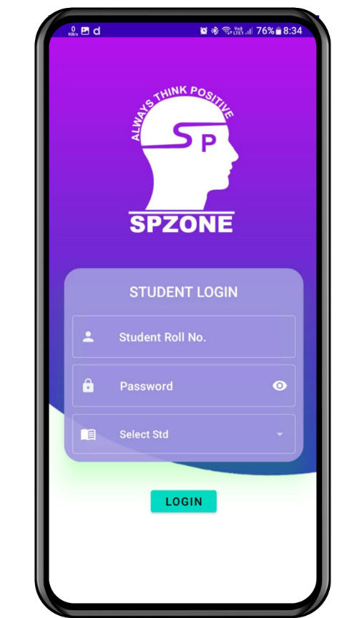
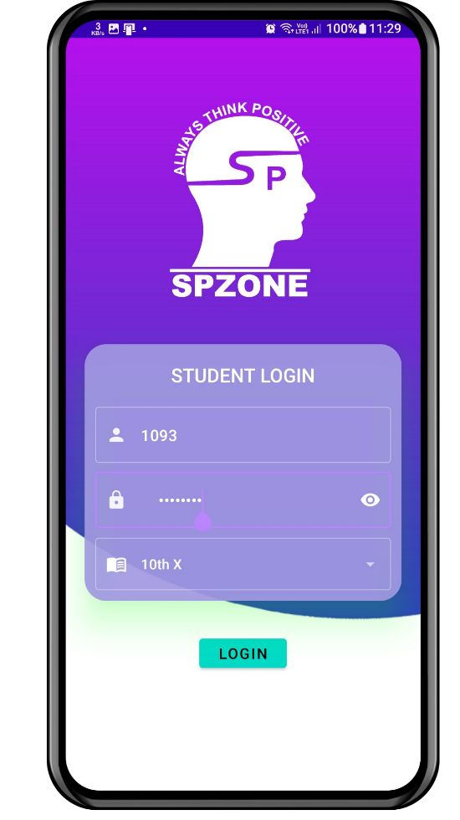
Login screen

Slide 18
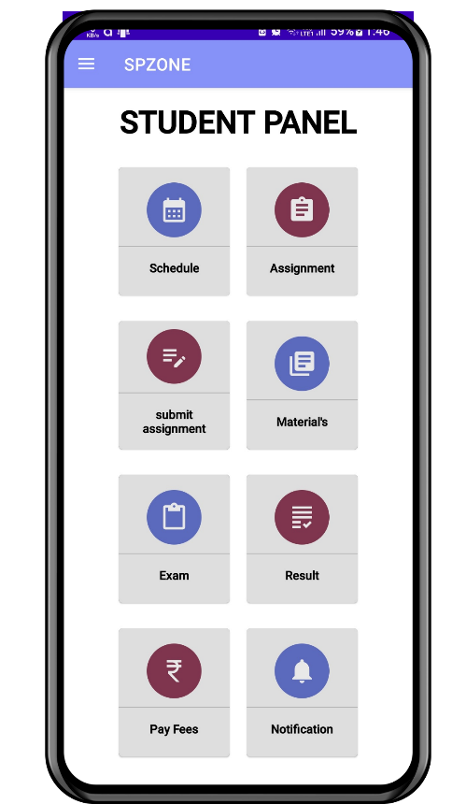
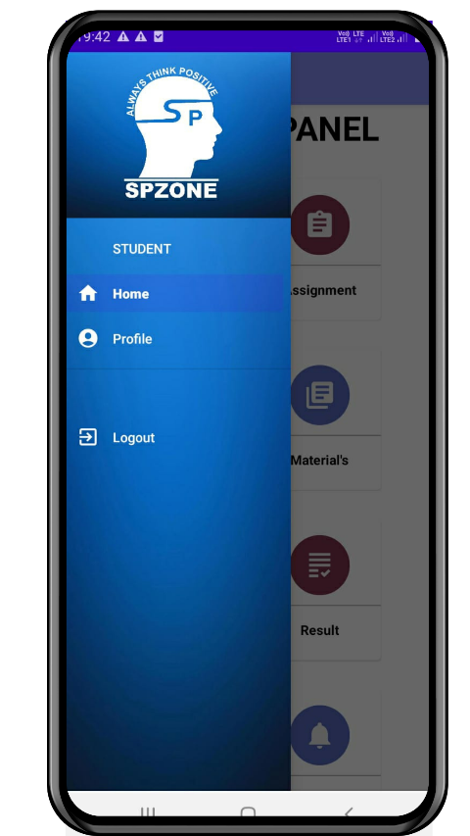
Dashboard and side navigation

Slide 19
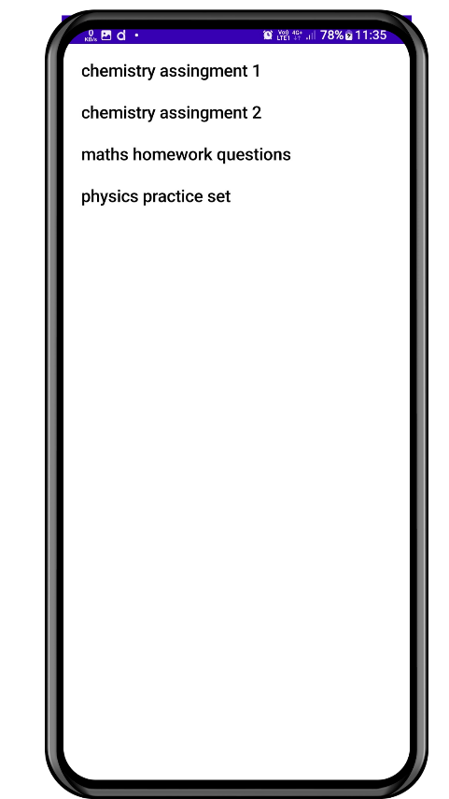
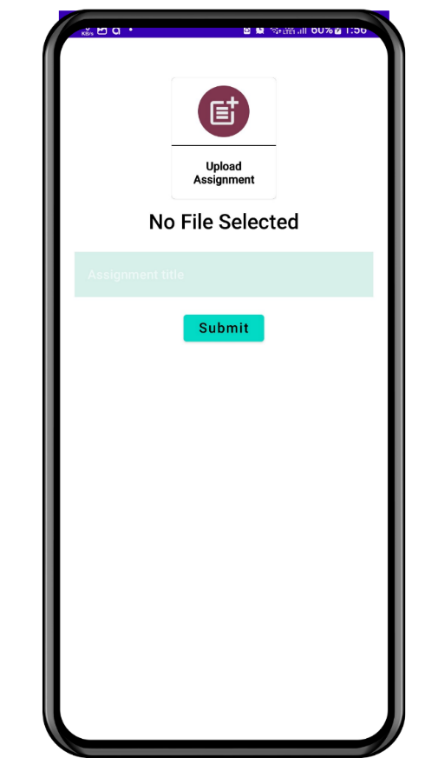
View/submit assignment

Slide 20
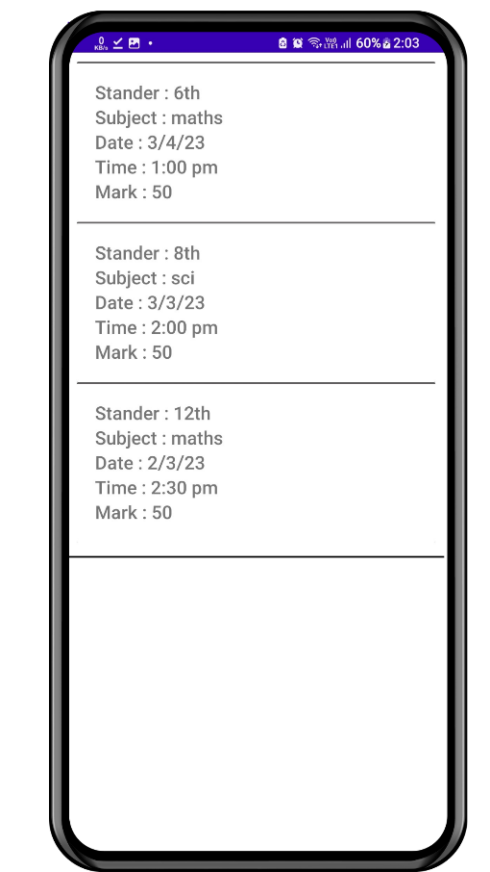
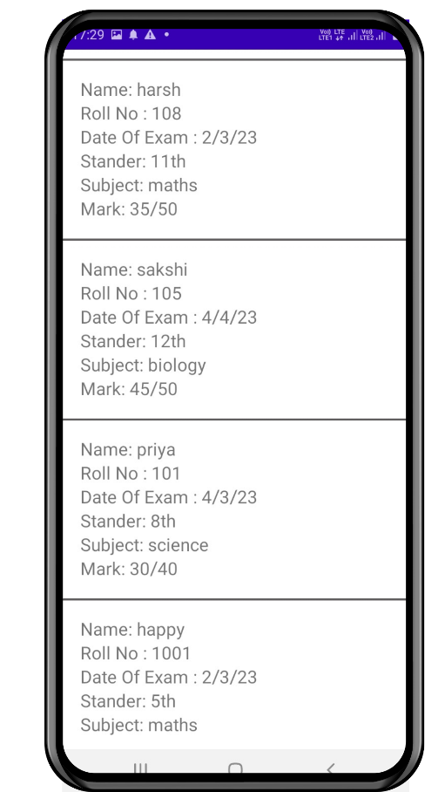
Exam details and results

Slide 21
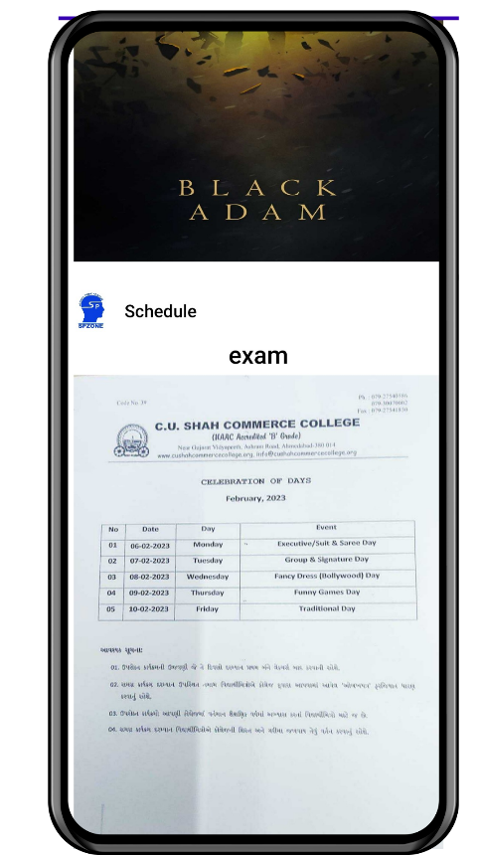
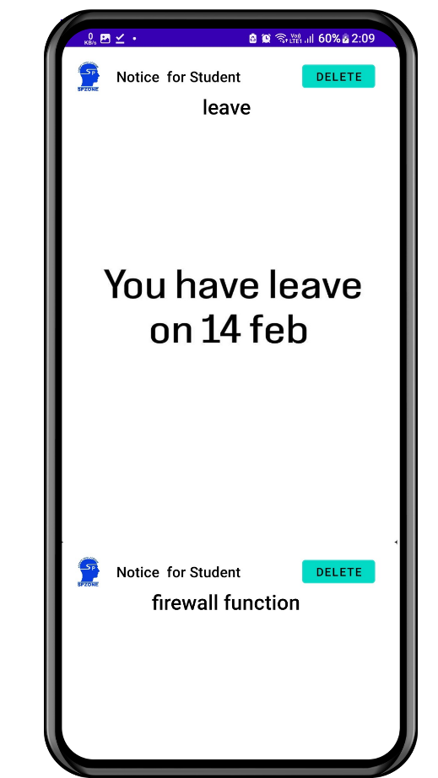
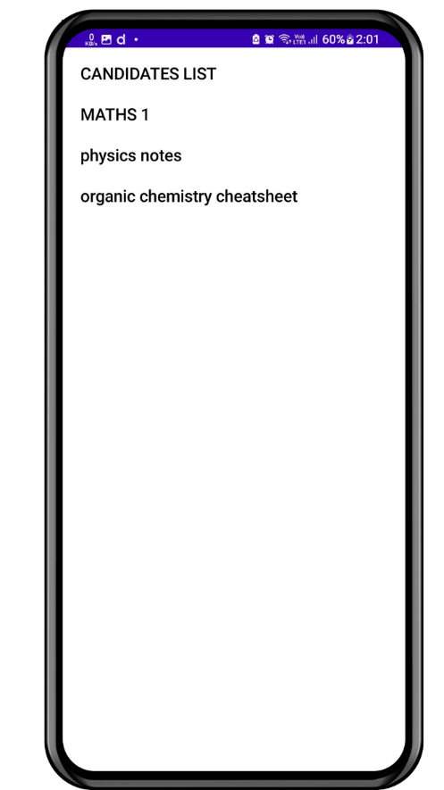
Schedule, notification, material

Slide 22
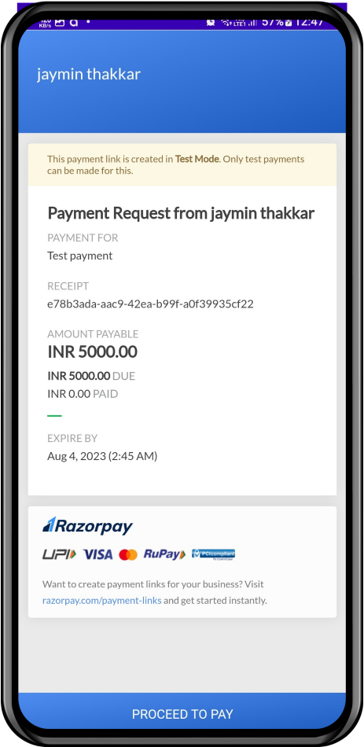
Pay fees -01

Slide 23

Pay fees -02

Slide 24
03
Teacher App
User panel consists of teachers and students

Slide 25
Splash and Home page

Slide 26
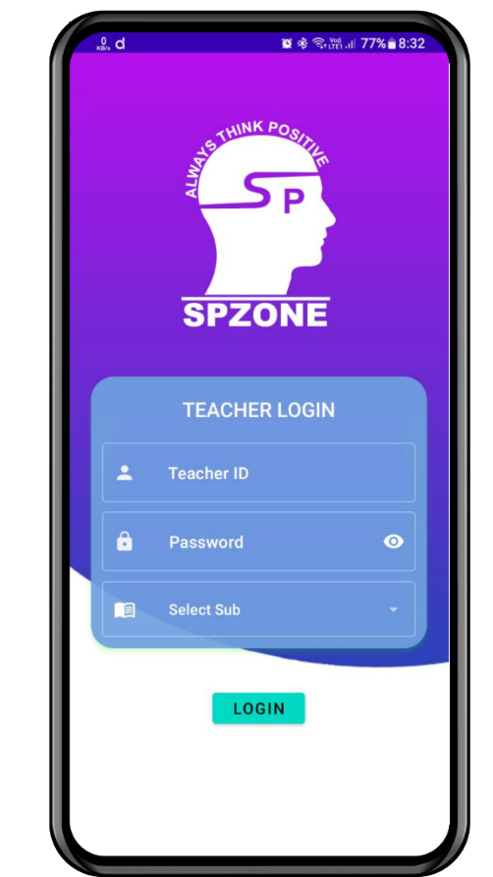
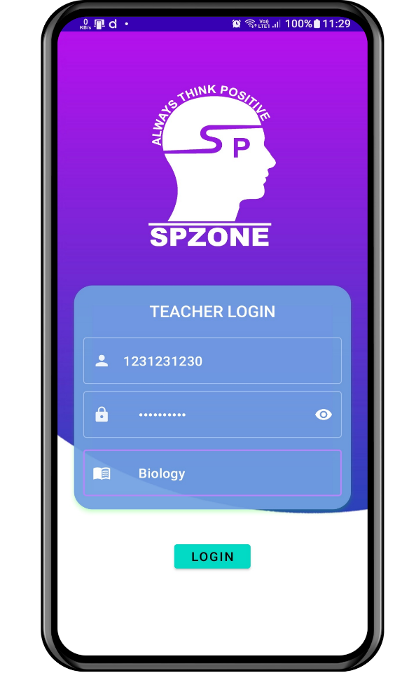
Login screen

Slide 27
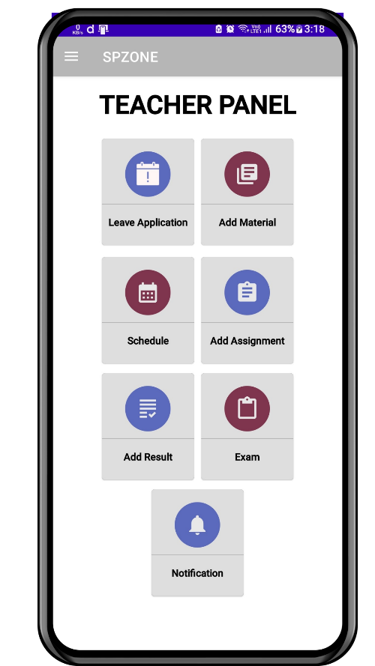
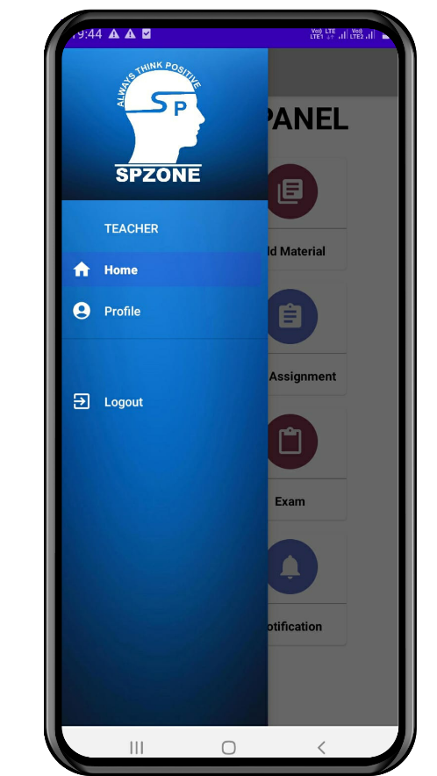
Dashboard and side navigation

Slide 28
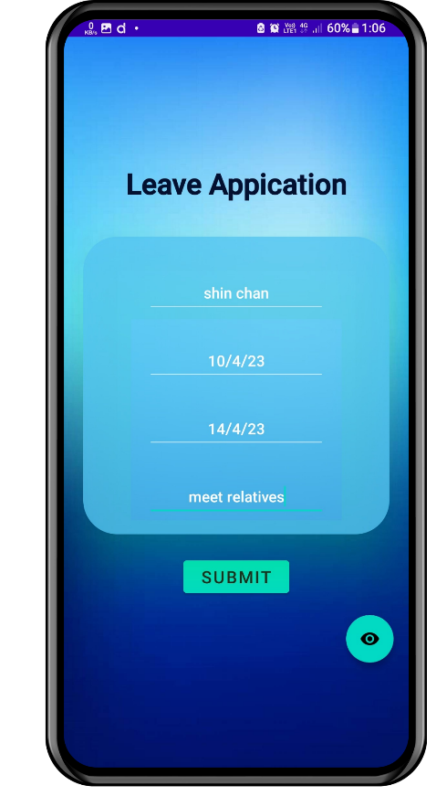
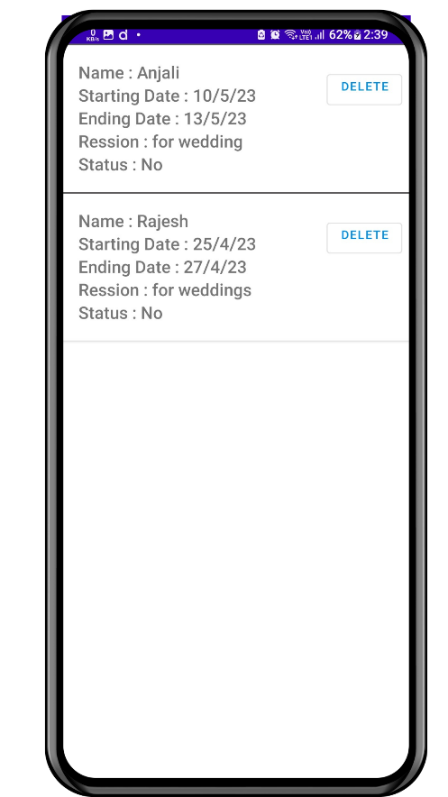
Leave Application

Slide 29
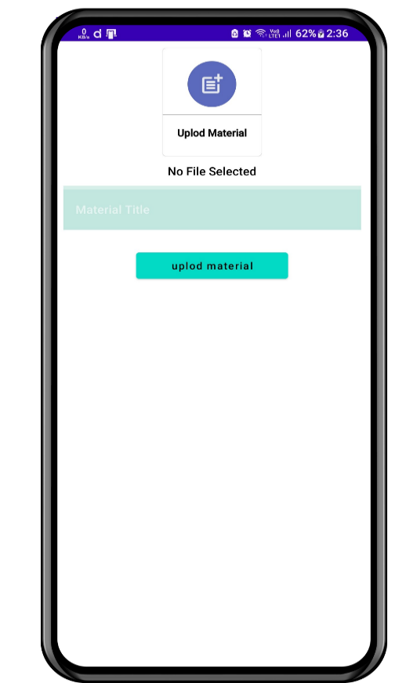
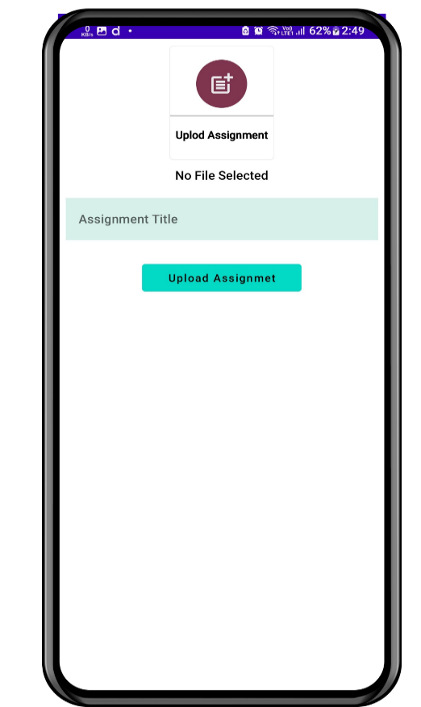
Upload Materials/ Assignments

Slide 30
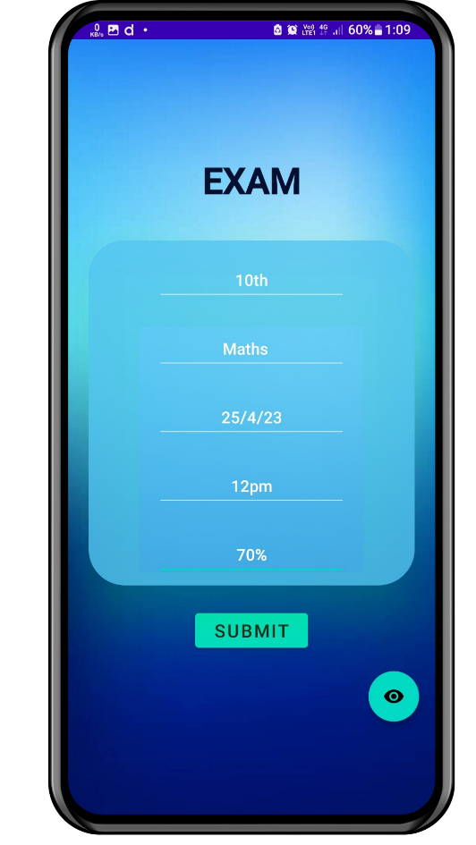
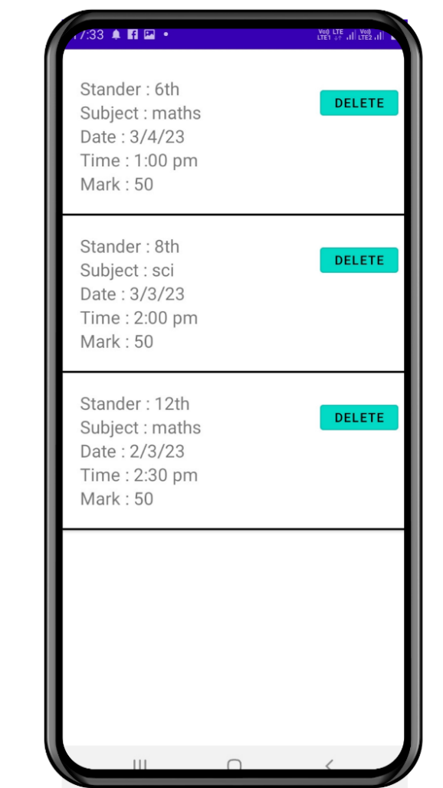
Upload Exam Details

Slide 31
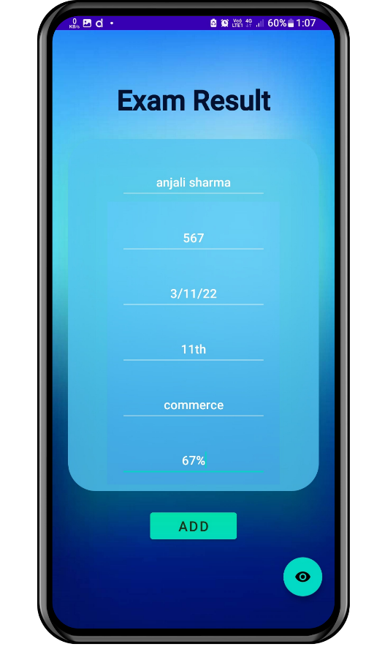
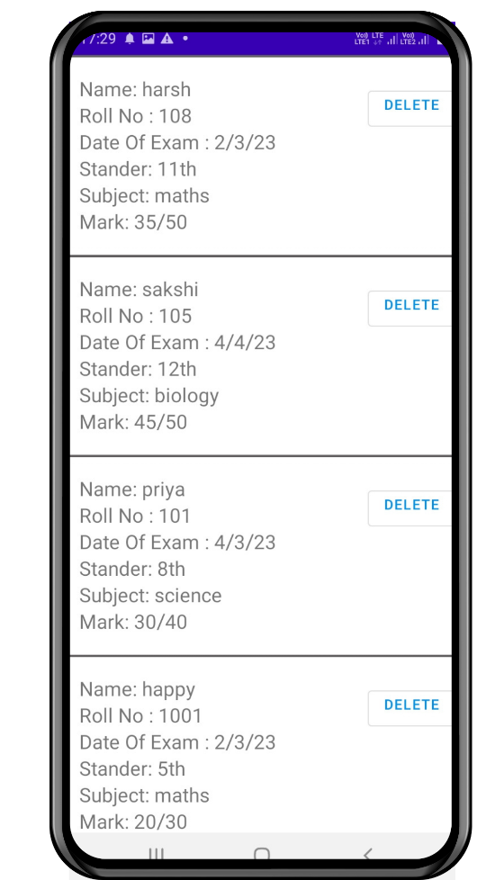
Upload Exam Results

Slide 32
View notification, schedule

Slide 33
Thank you

